Slide 1

PAWFECT PAWS GROOMING SYSTEM
VAISHNAVI K
MES24MCA-2059
Department of Computer Applications
MES College of Engineering, Kuttippuram
20-8-2025

Slide 2
PRODUCT OWNER C M SULAIKHA ASSISTANT PROFESSOR DEPARTMENT OF COMPUTER APPLICATIONS MES COLLEGE OF ENGINEERING, KUTTIPPURAM

Slide 3
TABLE OF CONTENTS
Introduction
Objective
Existing System
Proposed System
Motivation
Functionalities
Module Description
Developing Environment
Sprint Backlog
Product Backlog
User Story
Project Plans
Data Flow Diagrams
ER Diagram

Slide 4
PAWFECT PAWS GROOMING SYSTEM
Give Project Overview using bullet points (1 to 2 slides)

Slide 5
OBJECTIVES
Streamline and Modernize Pet Grooming Services: Design a system to address operational challenges faced by grooming businesses.
Simplify Appointment Scheduling: Automate and enhance the process of scheduling appointments for both customers and administrators.
Improve Customer Management: Provide tools for efficient customer management, including profile creation and updates.
Enhance Service Management: Enable easy management of service offerings, including adding, updating, and browsing service catalogs.
Implement Secure Authentication: Ensure data security and privacy by using secure authentication protocols and safeguarding user information.
Support User Authentication and Role-Based Access Control: Allow customers to register, log in, and manage their profiles, while administrators have advanced permissions to oversee all aspects of the platform.

Slide 6
EXISTING SYSTEM
Pet grooming services managed manually or with basic tools
Appointments scheduled via phone calls or walk-ins
Customer and pet records stored in paper files or spreadsheets
No centralized platform for service and data management
Time-consuming administrative tasks due to lack of automation
Limited access to pet grooming history and preferences
Minimal data security; risk of information loss or misuse
Poor scalability for growing business needs
Inconsistent customer experience and fragmented service tracking

Slide 7
PROPOSED SYSTEM
Centralized web-based platform for managing pet grooming services
User-friendly interface for customers and administrators
Secure customer registration and login with role-based access
Pet profile creation with photo uploads and detailed attributes
Service catalog browsing and appointment booking functionality
Automated appointment scheduling and cancellation system
Admin dashboard for managing users, services, and appointments.

Slide 8
MOTIVATIONS
Rising consumer expectation for “book-anytime, anywhere” convenience in pet services.
Manual scheduling & paper records causing double-bookings, errors, and lost revenue.
Lack of centralized, secure customer/pet data limits personalized care and upselling.
Need to boost customer loyalty through transparent pricing, instant confirmations, and timely reminders.
Competitive pressure to modernize operations and stand out from traditional groomers.
Desire for real-time analytics to guide staffing, marketing, and service expansion decisions.
Opportunity to future-proof the business with a scalable platform ready for online payments, loyalty programs, and mobile apps.

Slide 9
FUNCTIONALITIES
User Registration & Login :Secure access with role-based authentication.
Pet Profile Management: Add, update, and view pet details with photos.
Service Catalog Browsing :Explore grooming services with pricing info.
Appointment Booking & Cancellation:Schedule or cancel appointments easily.
Customer Dashboard :View appointments, pet profiles, and service history.
Admin Panel :Manage users, services, and appointments efficiently.
Secure Authentication :Protect user data with robust login protocols.

Slide 10
MODULE DESCRIPTION
Customer Module
User authentication & profile management (register, log in, edit info).
Create/update pet profiles (upload photos, include breed, age, details).
Browse service catalog with pricing and descriptions.
Book,view,schedule,or cancel appointments.

Slide 11
MODULE DESCRIPTION
Administrator Module
Manage user accounts and customer profiles.
Oversee appointment schedules and service operations.
Update and maintain service catalog (pricing, descriptions, offers).
Monitor data consistency, minimize errors, and ensure smooth workflows.

Slide 12
DEVELOPING ENVIRONMENT
Operating System: Windows 11
Frontend: HTML5, CSS, Bootstrap, JavaScript
Backend: Python 3
Framework: Django (Python-based web framework)
Database: SQLite
IDE / Development Environment: PyCharm.
Web Browser (for Testing):Google Chrome / Microsoft Edge

Slide 13
SPRINT BACKLOG
Backlog tem | Status And Completion Date | Original Estimation in Hours | Day 1 hrs | Day 2 hrs | Day 3 hrs | Day 4 hrs | Day 5 hrs | Day 6 hrs | Day 7 hrs | Day 8 hrs | Day 9 hrs | Day 10 hrs
SPRINT1
Table designing | 16/8/2022 | 2 | 1 | 1 | 0 | 0 | 0 | 0 | 0 | 0 | 0 | 0
Form designing | 22/8/2022 | 3 | 1 | 1 | 1 | 0 | 0 | 0 | 0 | 0 | 0 | 0
Coding | 27/8/2022 | 3 | 1 | 1 | 1 | 0 | 0 | 0 | 0 | 0 | 0 | 0
SPRINT 2
Data collection | 13/9/2022 | 7 | 1 | 1 | 1 | 1 | 1 | 1 | 1 | 0 | 0 | 0
Data processing | 29/9/2022 | 7 | 1 | 1 | 1 | 1 | 1 | 1 | 1 | 0 | 0 | 0
The table given above is for reference only. Update/create a table with your data.

Slide 14
SPRINT BACKLOG
Backlog tem | Status And Completion Date | Original Estimation in Hours | Day 1 hrs | Day 2 hrs | Day 3 hrs | Day 4 hrs | Day 5 hrs | Day 6 hrs | Day 7 hrs | Day 8 hrs | Day 9 hrs | Day 10 hrs
SPRINT3
Course contents | 3/10/2022 | 7 | 1 | 1 | 1 | 1 | 1 | 1 | 1 | 0 | 0 | 0
Assassement | 20/10/2022 | 7 | 1 | 1 | 1 | 1 | 1 | 1 | 1 | 0 | 0 | 0
SPRINT 4
Certificate | 8/11/2022 | 7 | 1 | 1 | 1 | 1 | 1 | 1 | 1 | 0 | 0 | 0
Testing | 15/11/2022 | 7 | 1 | 1 | 1 | 1 | 1 | 1 | 1 | 0 | 0 | 0
TOTAL |  | 50 | 9 | 9 | 8 | 6 | 6 | 6 | 6
The table given above is for reference only. Update/create a table with your data.

Slide 15
PRODUCT BACKLOG
ID | NAME | PRIORITY <high/medium/low> | ESTIMATE (Hours) | STATUS <Planned/In progress/Completed>
1 | REGISTRATION | High | 5 | COMPLETED
2 | LOGIN | High | 5 | COMPLETED
3 | CRUD(Course,Student,University) OPERATIONS | High | 20 | COMPLETED
4 | STUDENT ENROLLMENT | High | 10 | COMPLETED
5 | CERTIFICATE GENERATION | MEDIUM | 10 | COMPLETED
The table given above is for reference only. Update/create a table with your data.

Slide 16
USER STORY
User Story ID | As a type of User | I want to <Perform some task> | So that i can <Achieve Some Goal>
1 | ADMIN | Login | login successful with correct username and password
2 | ADMIN | View and Manage | Can view and Manage registered users,Faculties and Universities
3 | ADMIN | Verification | Verify Courses
4 | USER | Register | Can users register
5 | USER | Login | login successful with correct username and password
6 | USER | Enrollment | Can enroll in any Courses
7 | USER | View Profile | View users profile in application
The table given above is for reference only. Update/create a table with your data.

Slide 17
PROJECT PLAN
User StoryID | Task Name | Start Date | End Date | Days | Status
1 | Sprint 1 | 16/08/2022 | 17/08/2022 | 10 | Completed
4 |  | 18/08/2022 | 19/08/2022 |  | Completed
5 |  | 20/08/2022 | 22/08/2022 |  | Completed
10 |  | 23/08/2022 | 24/08/2022 |  | Completed
11 |  | 25/08/2022 | 27/08/2022 |  | Completed
2 | Sprint 2 | 13/09/2022 | 23/09/2022 | 16 | Completed
7 |  | 23/09/2022 | 24/09/2022 |  | Completed
12 |  | 24/09/2022 | 29/09/2022 |  | Completed
The table given above is for reference only. Update/create a table with your data.

Slide 18
PROJECT PLAN
User StoryID | Task Name | Start Date | End Date | Days | Status
3 | SPRINT 3 | 03/10/2022 | 06/10/2022 | 14 | Completed
6 |  | 07/10/2022 | 10/10/2022 |  | Completed
13 |  | 13/10/2022 | 20/10/2022 |  | Completed
14 | SPRINT 4 | 28/10/2022 | 5/11/2022 | 10 | Completed
8 |  | 7/11/2022 | 11/11/2022 |  | Completed
9 |  | 13/11/2022 | 15/11/2022 |  | Completed
The table given above is for reference only. Update/create a table with your data.

Slide 19
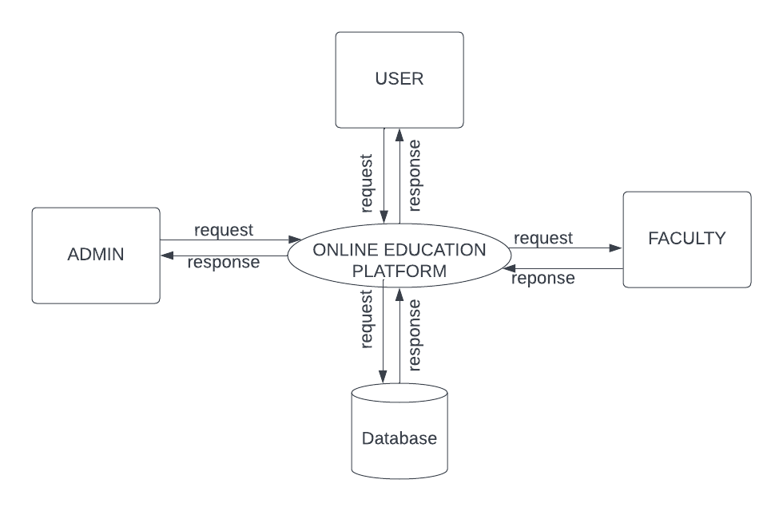
DATA FLOW DIAGRAM
LEVEL 1
The figure given above is for reference only. Create a figure with your data.

Slide 20
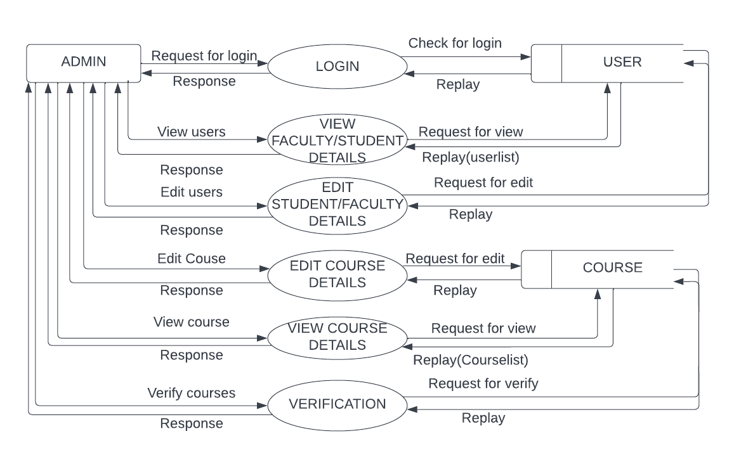
DATA FLOW DIAGRAM
Level 1.1
The figure given above is for reference only. Create a figure with your data.

Slide 21
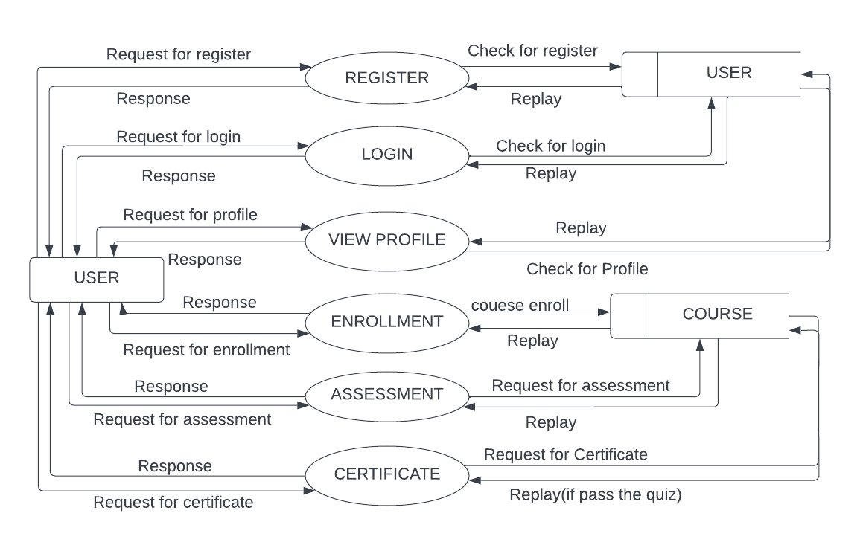
DATA FLOW DIAGRAM
Level 1.2
The figure given above is for reference only. Create a figure with your data.

Slide 22
ER DIAGRAM
Place you ER Diagram (if any) here.

Slide 23
THANK YOU

